Slide 1


Forensic Pharmacy-Indian Patent Act 1970

Slide 2
The enactment of the Indian Patents Act (IPA), 1970 was a revolutionary step taken by the then Government with Late Smt. Indira Gandhi as the
Prime Minister of the country.
This Act was aimed at giving an impetus to the industrial and economic growth within the country by adopting process-patent strategy.
The effective implementation of this Act between
1970 and establishment of World Trade Organization (WTO) in 1995
yielded desired results of increased production of different commodities
by Indian industrial sector especially, in the field of drugs and
pharmaceuticals.
Before the enactment of IPA, 1970, the Indian
pharmaceutical industry was largely depending upon import of drugs
and technology and indigenous pharmaceutical sector was not in a position to compete mighty foreign companies established long back in the country.

Slide 3
The provision of process-patent, and not the product-patent, provided in the Act was one of the important landmarks in enhancing the bulk drug production in the country.

Slide 4
Patent : It is a grant in form of a document by the Government for
disclosing a new invention by applicant
Intellectual Property : It is a class of property emanating from
human intellectual abilities and means Patents, Designs Copyrights,
Geographical Indications, Trademarks, etc.
The legal rights pertaining to Intellectual Property are summed up as Intellectual Property Rights (lPR).
Invention: means a new product or process involving an inventive
step and capable of industrial application. Inventive step means a
feature that makes the invention not obvious to a person skilled in the art.

Slide 5
Inventions not patentable
(Under Section 3 of the Indian Patents Act, 1970.)
• Claims contrary to established natural laws.
• Mere discovery of'scientific principle.
• Substance obtained by mere admixture with improved properties.
• Re-arrangement or duplication of known devices.
• Method of agriculture or horticulture.
• Mere discovery of a new property or new use of a known substance or apparatus. ..
• An invention, the primary or unitended use of which would be
injurious to public health.
• Any process for medicinal, prophylactic, surgical, curative,
diagnostic, therapeutic or other treatment of human beings.
• Plants and animals except micro-organisms in whole or any
part thereof including species, varieties of seed, propagation of
plants and animals.

Slide 6
Aggregation or duplication of known properties of traditionally
known component.
A computer program per se other than its technical utility to
industry or a combination with hardware.
A method or process of testing applicable during the process of manufacture.
A literary, musical, artist, dramatic work including television and cinematographic work.
Topography of integrated circuits.
Presentation of information.
A mere scheme or method or rule of performing mental act or method of playing
Production, control, use or disposal of atomic energy or specific activities related to processing of enriched or radioactive
substance as per Atomic Energy Act, 1962.

Slide 7
Types of Patents
Ordinary patent: It is granted on an ordinary application made.
(ii) Patent for addition : It is secured for an improvement or
modification to granted patent. It remains in force till the original
patent is valid.
(iii) Patent granted under convention agreement : It is based
on an application made in a Convention Country notified under
Section 133 of the Act. The convention application has to be
made within 12 months from the date of the first application.
It is now possible to secure patent protection for new products and the processes of preparation in Science & Technology and also for a new hardware.

Slide 8
The main criteria for securing patents are:
(i) The invention must be new.
(ii) It should involve inventive step.
(iii) The invention must be industrially applicable and useful to the society.
Even though, product-patent is the key factor in post-WTO era, it does not prevent a person to get a patent for developing alternate and commercially viable new processes for the new product.
The alternate and commercially viable process developed can not be commercially used without getting the permission of the valid product patent holder.

Slide 9
Term of Patent
In accordance with amendment in 2002 to Section 33, the term of patent is 20 years and shall also be applicable to those patents granted under The Patents Act, 1970 from the date of amendment.
Administration
The Head Quarter of Patent Office is in Kolkatta with its branches in Mumbai, Delhi and Chennai. The Nodal Ministry is Ministry of Commerce and Industry, Department of Industrial Policy and Promotion, Government Of India, Udyog Bhavan, New Delhi.

Slide 10
Requirements
The documents required in duplicate for filing an application for patent in India are as follows:
(i) Application Form 1 suitably modified.
(ii) Provisional Certification (Form 2) or Complete Specification
(Form 2).
(iii) Abstract of invention.
(iv) Any drawings, if necessary.
(v) Statement and Undertaking (Form 3)
(vi) Prescribed fees.

Slide 11
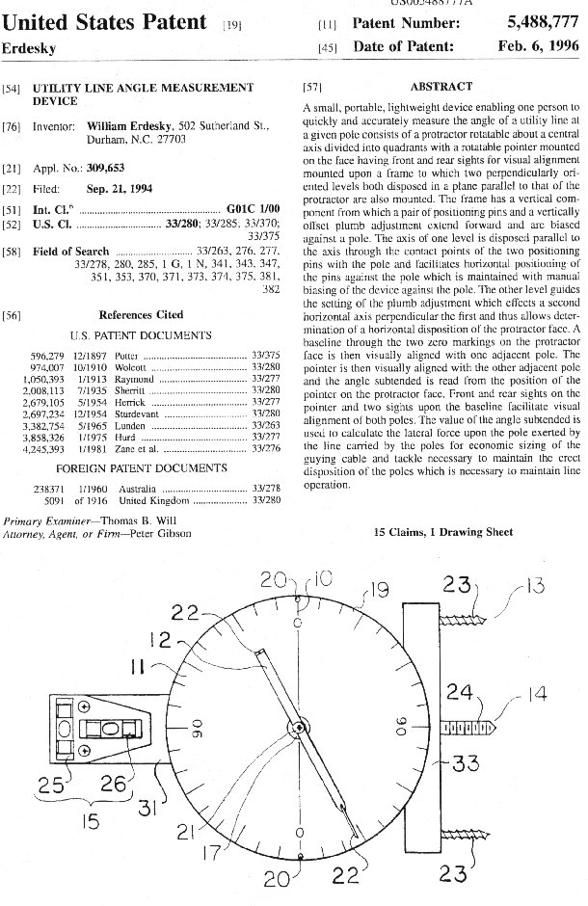

Slide 12
Inventions Patentable
Development and process for the preparation of new compounds, new materials, new formulations or synergistic compositions; improvement of an existing process for production of known compounds, known compositions and known materials; development of new medical kit, new machine/device, new hardware incorporating a software and improved machine device are patentable.

Slide 13
Patent Search
The patents are categorized under the National Patent Systems of every country as well as under an International Patent Classification System (IPC).
The IPC system of classification categorizes the entire Science
and Technology into 8 main headings, each heading is further classified into about 95000 sub-headings.

Slide 14
Rights of Patentee
The rights of the patentee are defined in Section 48 of the Act.
The grant of a product patent prevents a person in commercially utilizing the process he has developed for the preparation of the product patent holder.
The patent holders for respective invention can come together
and enter into joint agreement for mutual benefits, if the alternate
process developed has significant commercial utility.
The Patentee has an exclusive right to make use ofthe patent within
the period of patent, sell or distribute such an article.
He has right to prevent third parties who do not have his consent from the act of using that process.
For Government use under special provisions there is no restriction
for importing or making use of provision.
The patent is required to be surrendered if complaint is made and upheld by the order of High Court.

Slide 15
Infringement of Patent
When the legal rights in a valid patent are commercially exploited without the permission of the patentee, it amounts to infringement of patent.
The relief, which a court may grant in any suit for infringement
includes an injunction and at the option of the plaintiff either damages or an account of profits.
Other Features
• The legal rights in Intellectual Property secured (except for Copy Right) in one country can not be enforced in another country.
• For availing the benefits of the Patent Cooperation Treaty (PCT)
Rules, a single application (International Application) has been
made in respect of designated member countries of PCT, where
protection is desired. Afterwards the applicant, however, has to
make corresponding applications in the member countries of PCT.

Slide 16
The amendments effected have a provision for establishment of
an "Appeal Board", the qualifications for the members of the
Board which shall look into IP disputes and provide speedy, timely and inexpensive disposal of appeals.
"Protection of National Security" clause has been inserted whereby, the Central Government can take any action including revocation of a patent in the interest of the security of India by issuing notification in the Official Gazettt: to that effect.
The Patent Amendment 2005 covering product protection has provided an opportunity for domestic players to invest in R&D and bring out successful drugs at a greatly reduced cost.

Slide 17
Governing Laws in India for IPR as follows:
1.Patent Act 1970
2. Trade Marks Act (1958 original) 1999
3. The Copyright Act 1957
4. The design Act 2000
5. Geographical Indication of Goods (Registration and Protection) Act 1999
6. Plant Variety and Farmers Right Protection Act 2001

Slide 18
Patentability searches:
Patentability search is a search for invention in hope of not finding the invention.
The patentability search is an universal concept since inventions cannot be boundary constraint.
But it is to be noted that the patent laws are territorial. Computer databases search is quick and relatively inexpensively.
Database searches are most useful in searching sophisticated inventions, which can be described by precise, well-known terms of art.
They are much less useful in searching mechanical gadget type inventions. No search will "guarantee" the patentability of any invention.
The object is to make a reasonable assessment of the prospects for obtaining worthwhile patent protection.
Search results are also useful in preparing a patent application.

Slide 19
Both product and process patent provided
Term of patent – 20 years
Examination on request
Both pre-grant and post-grant opposition
Fast track mechanism for disposal of appeals
Provision for protection of bio-diversity and traditional knowledge
Publication of applications after 18 months with facility for early publication
Substantially reduced time-lines

Slide 20
Safeguards in the Patent Law
Compulsory license to ensure availability of drugs at reasonable prices
Provision to deal with public health emergency
Revocation of patent in public interest and also on security considerations

Slide 21
Stages from filing to grant of a patent

Slide 22
Obtaining a patent
File an application for patent
  With one of the patent offices based on territorial jurisdiction of the place of office or residence of the applicant /agent
  Pay the required fee
Information concerning application form and details of fee available at www.ipindia.nic.in
Guidelines for applicants also available on this website

Slide 23
Formality Check
An Examiner checks the formal requirements before accepting the application and the fee – this is done immediately
Issue of application number and the cash receipt – this is done the same day
In case of receipt of application by post, cash receipt, application number is sent by post within 2-3 days

Slide 24
Publication
Application is kept secret for a period of 18 months from the date of filing
In 19th month, the application is published in the official journal – this journal is made available on the website weekly
Applicant has an option to get his application published before 18 months also
In that case, application is published within one month of the request

Slide 25
Request for Examination
Application is examined on request
Request for examination can be made either by the applicant or by a third party
A period of 48 months, from the date of filing, is available for making request for examination

Slide 26
Examination
Application is sent to an Examiner within 1 month from the date of request for examination
Examiner undertakes examination w.r.t.
  whether the claimed invention is not prohibited for grant of patent
  whether the invention meets the criteria of patentability

Slide 27
Issue of FER
A period of 1 to 3 months is available to Examiner to submit the report to the Controller
1 month’s time available to Controller to vet the Examiner’s report
First Examination Report (FER) containing gist of the objections is issued within 6 months from the date of filing of request

Slide 28
Response from the Applicant
12 months’ time, from the date of issue of FER, is available to the applicant to meet the objections
If objections are met, grant of patent is approved by the Controller – within a period of 1 month

Slide 29
Pre-grant Opposition
After publication, an opposition can be filed within a period of 6 months
Opportunity of hearing the opponent is also available

Slide 30
Examination of Pre-grant Opposition
Opposition (documents) is sent to the applicant
A period of 3 months is allowed for receipt of response

Slide 31
Consideration of
Pre-grant Opposition
After examining the opposition and the submissions made during the hearing, Controller may
  Either reject the opposition and grant the patent
  Or accept the opposition and modify/reject the patent application
This is to be done within a period of 1 month from the date of completion of opposition proceedings

Slide 32
Grant of a Patent
A certificate of patent is issued within 7 days
Grant of patent is published in the official journal

Slide 33
STAGES - FILING TO GRANT OF PATENT
FILING OF APPLICATION
PROVNL. / COMPLETE
IF P.S.IS FILED C.S. TO BE FILED WITHIN 12MONTHS
PUBLICATION OF APPLICATION
PROMPTLY AFTER 18 MONTHS FROM P.D.
REQUEST FOR EXAMINATION
WITHIN 48 MONTHS FROM F.D.
EXAMINATION-ISSUE OF FER
3rd Party Representation
ALL OBJECTIONS TO BE COMPLIED WITHIN 12 MONTHS
GRANT OF PATENT
OPPOSITION
WITHIN 12 MONTHS
Decision of
Controller
Appeal
Revocation/Amendment
Appellate Board

Slide 34
Renewal Fee
To be paid within 3+6 months from date of recording in the register [sec 142 (4) ]
No fee for 1st and 2nd year
Renewal fee, on yearly basis, is required to be paid for 3rd to 20th for keeping the patent in force
Delay upto six months from due date permissible on payment of fee for extension of time
Patent lapses if renewal fee is not paid within the prescribed period

Slide 35


